Slide 1



Slide 2

About Koko’s Candy
Since 1995, Koko’s has been on a mission to make candy more than just a treat; we make it an experience. From iconic licensed favorites like ICEE, SLUSH PUPPiE, and Dippin’ Dots, to our own wildly popular creations, we’re all about flavor, fun, and a little bit of wow.
Our lineup is packed with playful goodies: candy jewelry, sprays, squeezes, popping candy, lollipops, gum! All with eye-catching displays and imaginative packaging, every product is designed to grab attention and spark smiles.
We’re also home to original hits like Popcifier®, Dip-N-Lik® and Twist-N-Lik™, plus a never-ending stream of inventive new candies that keep the fun (and the flavor) flowing.
Today, you’ll find Koko’s delights worldwide in just about every type of store: from grocery aisles and C-stores to family entertainment venues and big box retailers.
At Koko’s, we believe candy should taste amazing, look exciting, and feel like playtime -because everything we make is truly
Candy That Tastes Like Fun!

Slide 3




Meet the Team
Steve Kovens
President
Ellen Kepner
Product Development
Manager
Gerry Clothier
Vice President
of Sales
Nikki Schiavone
Vice President
of Marketing

Slide 4



Meet the Team
Greg Peter
Account Manager
Garry Popkin
Account Manager
Mahesh Pohoomull
International Sales

Slide 5
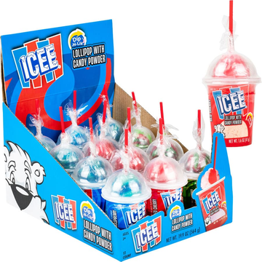
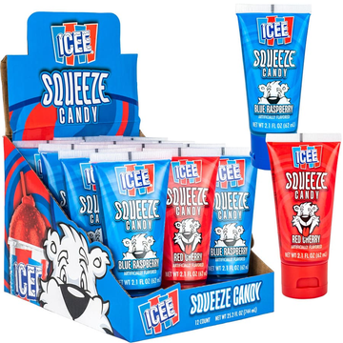
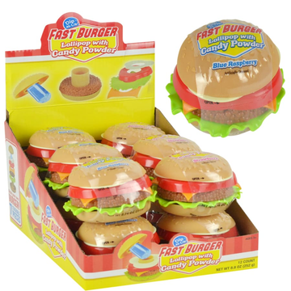
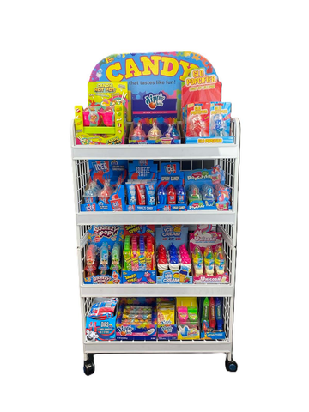

Proven Performance at Major Retailers
Proven Retail Performance
Strong sell-through Repeat orders Nationwide distribution
ICEE Dip-N-Lik
ICEE Squeeze Candy
Fast Burger
Koko’s novelty rack
Partner with Koko’s Candy
Proven novelty candy programs built
for sell-through and repeat purchase.
©2026 Koko’s Confectionery & Novelty. All Rights Reserved.
5

Slide 6







Winning Across Key Retail Channels
96% Sell-Through
& Expanded for
Holiday 2026
Fast-moving novelty candy program
Multi-item shelf display approved
5+ Year Retail Partner
Strong Growth in Grocery
National Distribution
Programs
150+ rack placements across TX + CA grocery chains
9 Core SKUs
in Assortment
ICEE Candy in Everyday Sets
Distributed through Top C&T Partners:
Core-Mark
H.T. Hackney
AMCON
1,400 Display
Units Placed
©2026 Koko’s Confectionery & Novelty. All Rights Reserved.
6

Slide 7





Winning Across Key Retail Channels
Mass
Grocery
Value
Specialty
Distribution
Everyday Candy Programs
carries Fast Burger Candy year-round
carries 9 everyday Koko’s SKUs
carries 9 Koko’s items
Licensed brands consumers already love
High-velocity novelty candy formats
Strong repeat retail orders
Proven shipper and rack programs
Distribution through top C&T wholesalers
Why Koko’s Wins
Retailers are choosing Koko’s for everyday sets thanks to strong brand recognition, novelty formats, and impulse appeal.
©2026 Koko’s Confectionery & Novelty. All Rights Reserved.
7

Slide 8


Slide 9



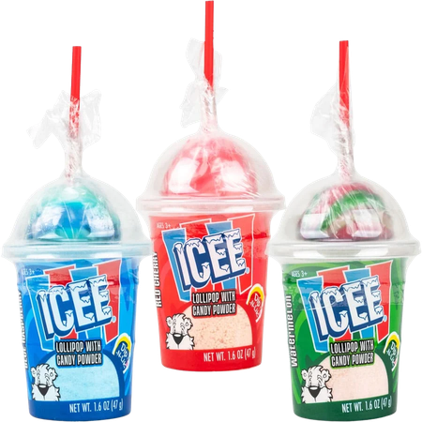
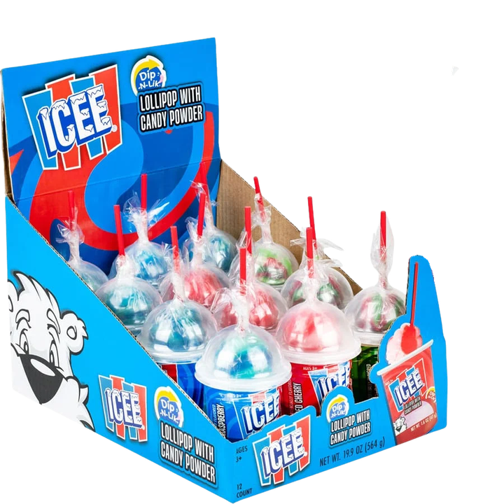
Best Seller & All-Time Favorite
Best Seller & All-Time Favorite
ICEE® Dip-N-Lik® Candy
#62511
12 per display
1.6 oz (47g) of candy
Display
6.88 x 9.13 x 5.44"
8 display boxes per case
Pricing
List unit cost: $1.03
©2026 The ICEE Company. ©2026 Koko’s Confectionery & Novelty. All Rights Reserved.

Slide 10

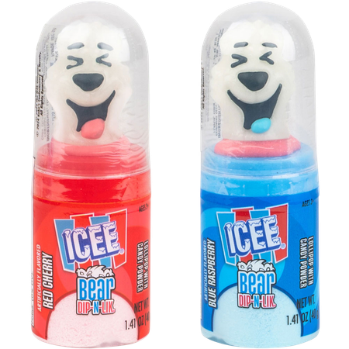
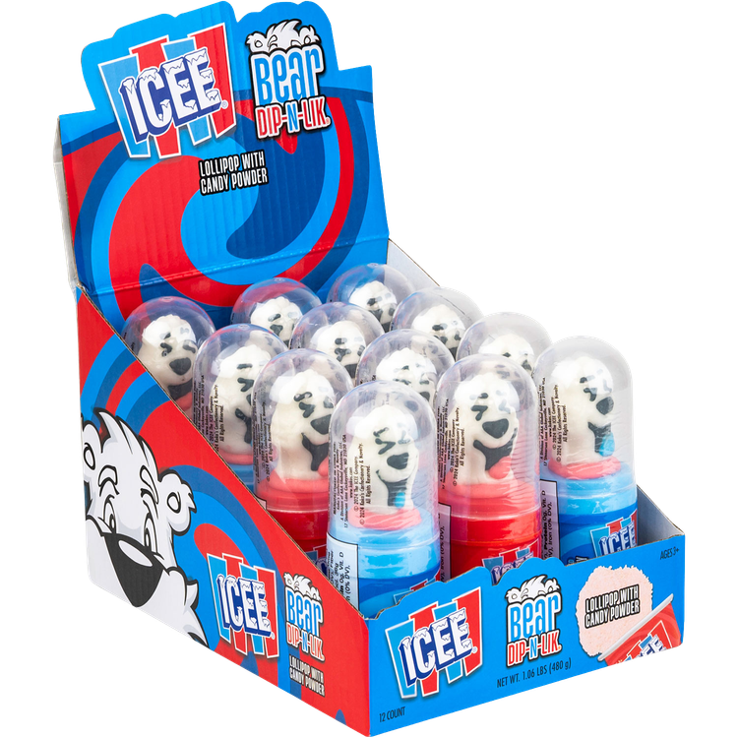
NEW
ITEM!
Best Seller & All-Time Favorite
Best Seller & All-Time Favorite
ICEE® Bear Dip-N-Lik® Candy
#62802
12 per display
1.41 oz (40g) of candy
Display
5.5 x 7.38 x 5.5
8 display boxes per case
Pricing
List unit cost: $1.03
©2026 The ICEE Company. ©2026 Koko’s Confectionery & Novelty. All Rights Reserved.

Slide 11
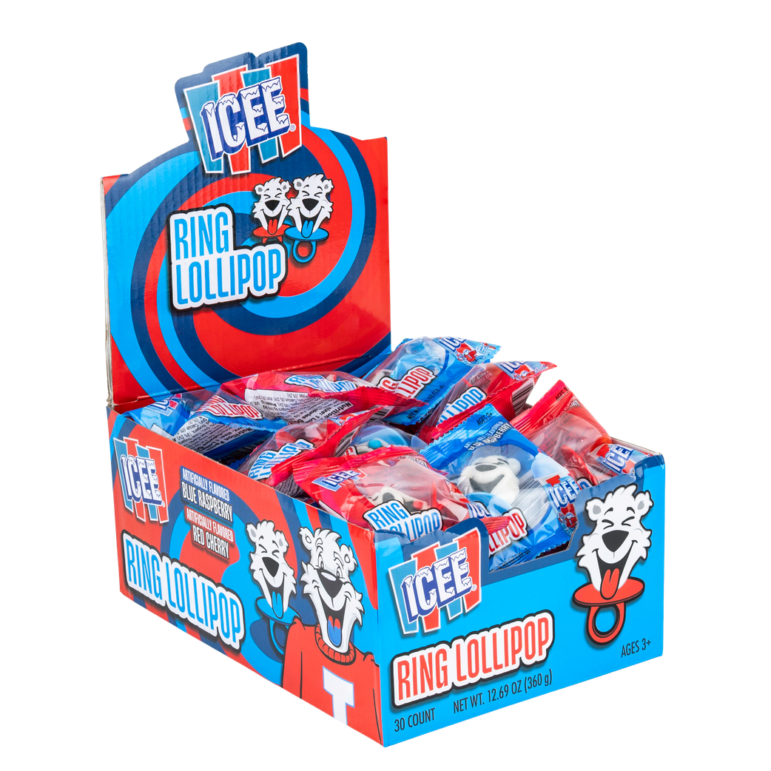
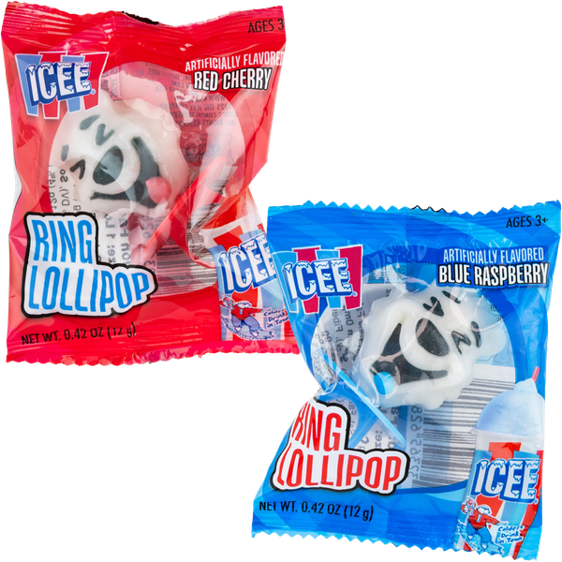
NEW
ITEM!
ICEE® Bear
Ring Lollipop
#62820
30 per display
0.42 oz (12g) of candy
Display
6.7 x 10.6 x 4.9"
6 display boxes per case
Pricing
List unit cost: $0.36
©2026 The ICEE Company. ©2026 Koko’s Confectionery & Novelty. All Rights Reserved.

Slide 12
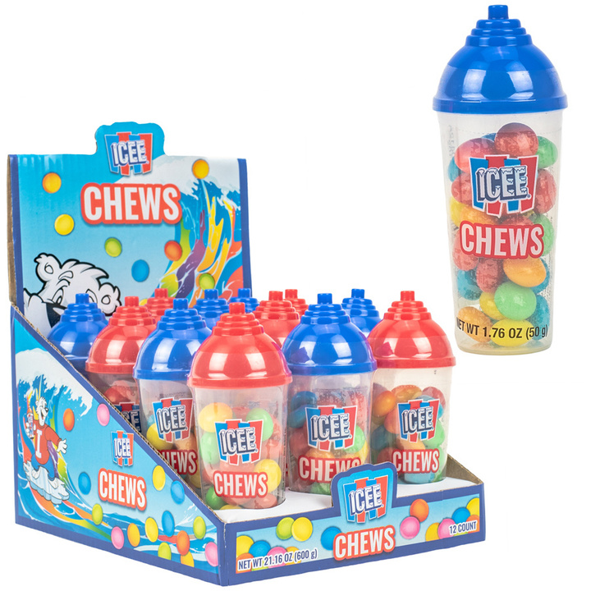
ICEE® Chews
#62690
12 per display
1.76 oz (50g) of candy
Display
5.75 x 7.75 x 4.5"
8 display boxes per case
Pricing
List unit cost: $0.95
©2026 The ICEE Company. ©2026 Koko’s Confectionery & Novelty. All Rights Reserved.

Slide 13
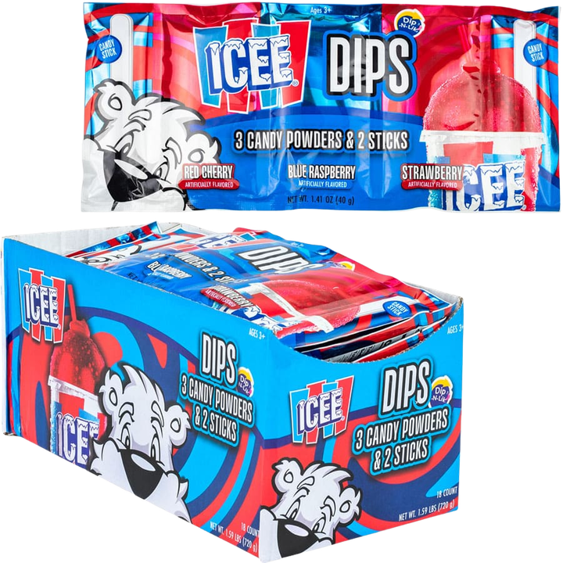
ICEE® Dips 3-Pack
Candy Powder/Sticks
#62740
18 per display
1.41 oz (40g) of candy
Display
6.3 x 9.45 x 4.34"
12 display boxes per case
Pricing
List unit cost: $0.64
©2026 The ICEE Company. ©2026 Koko’s Confectionery & Novelty. All Rights Reserved.

Slide 14
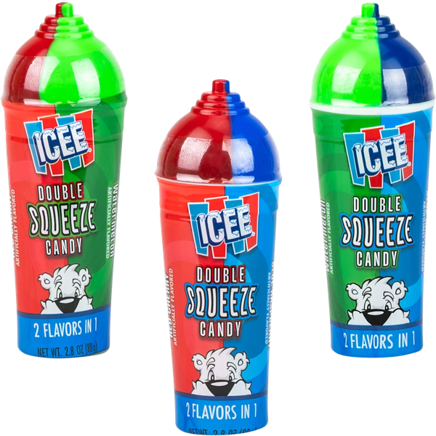
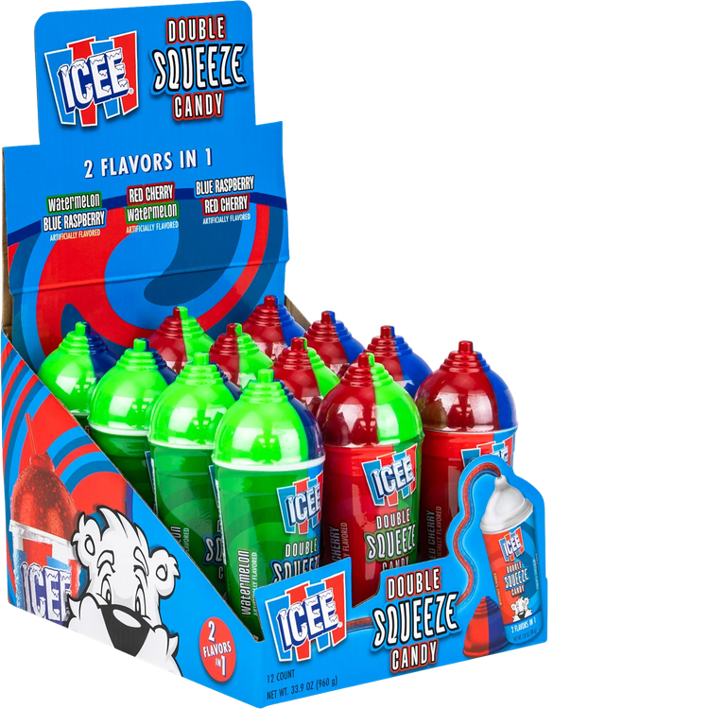
ICEE® Double Squeeze Candy
#62622
12 per display
2.82 oz (80g) of candy
Display
6.02 x 8 x 5.04"
6 display boxes per case
Pricing
List unit cost: $1.51
©2026 The ICEE Company. ©2026 Koko’s Confectionery & Novelty. All Rights Reserved.

Slide 15
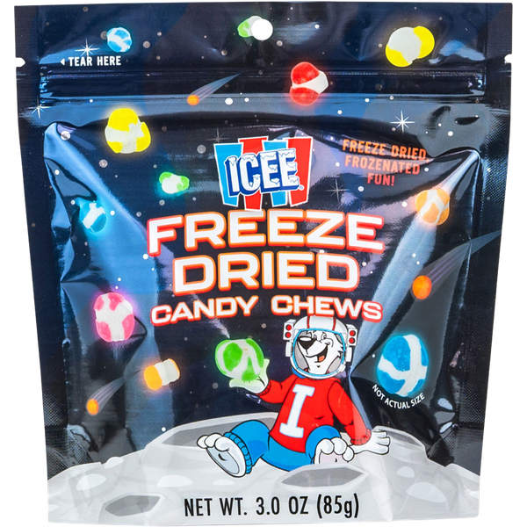
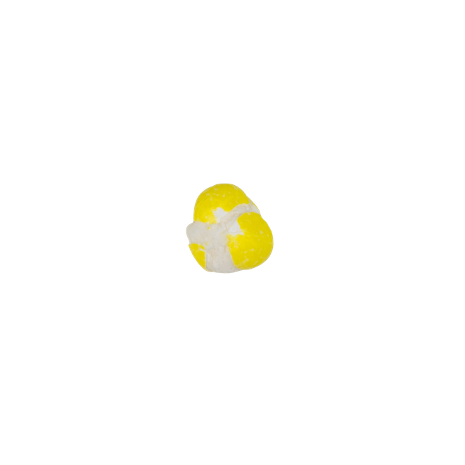

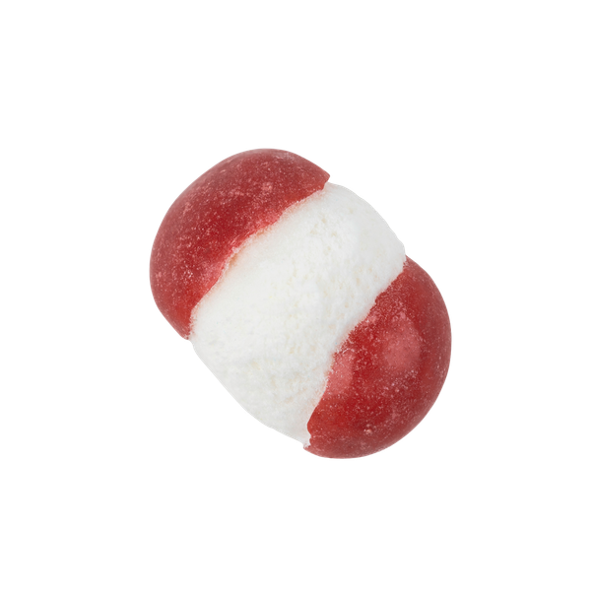
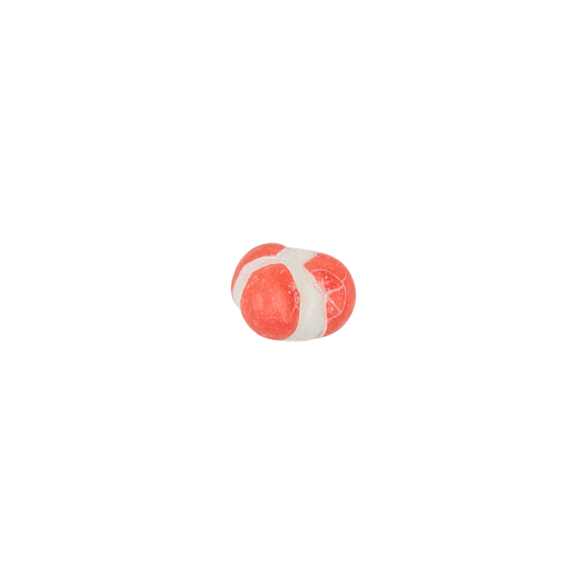
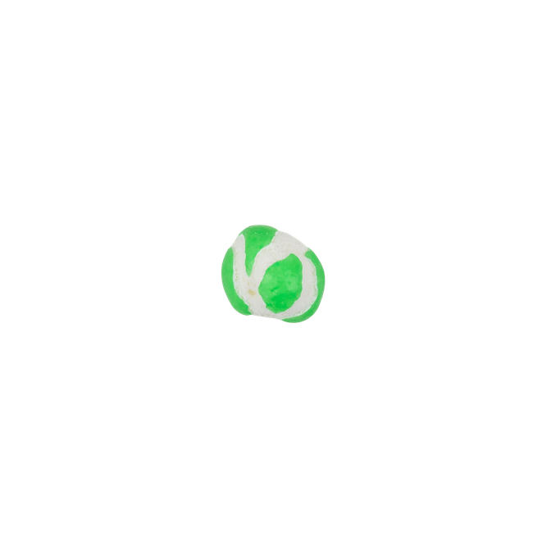
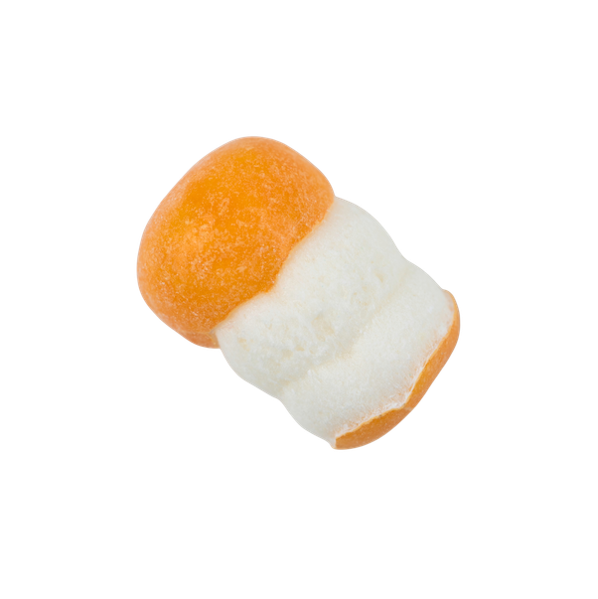
ICEE® Freeze Dried Candy Chews
#62786
3.0 oz (85g) of candy
Peg Bag
5 x 2 x 6"
12 per case
Pricing
List unit cost: $3.95
©2026 The ICEE Company. ©2026 Koko’s Confectionery & Novelty. All Rights Reserved.

Slide 16
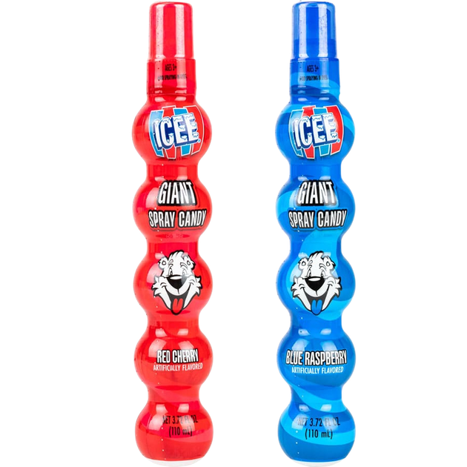
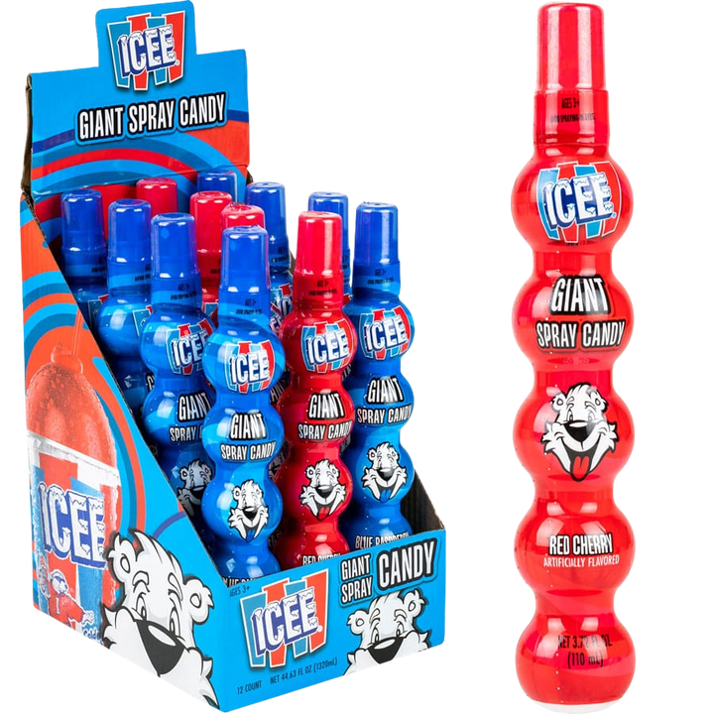
ICEE® Giant
Candy Spray
#62590
12 per display
3.72 fl oz (110mL) of candy
Display
5.13 x 6.44 x 8.44"
6 display boxes per case
Pricing
List unit cost: $1.51
©2026 The ICEE Company. ©2026 Koko’s Confectionery & Novelty. All Rights Reserved.

Slide 17
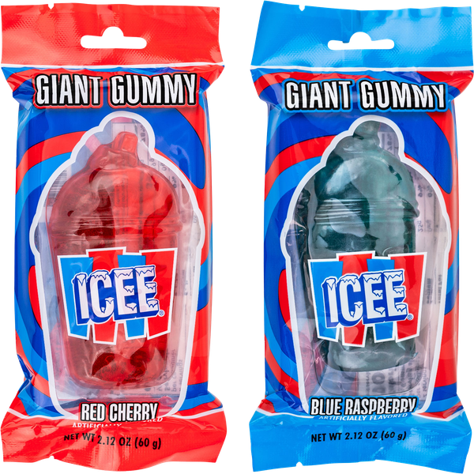
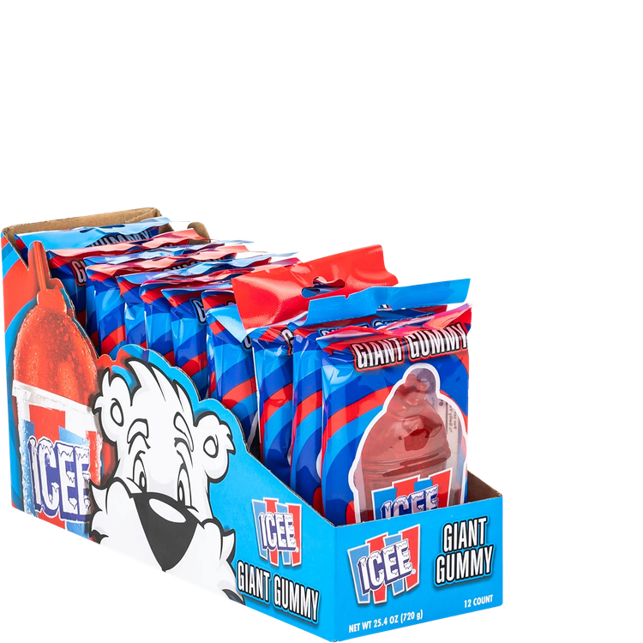
ICEE® Giant Gummy
#62634
12 per display
2.12 oz (60g) of candy
Display
3.63 x 11 x 5.5"
8 display boxes per case
Pricing
List unit cost: $1.03
©2026 The ICEE Company. ©2026 Koko’s Confectionery & Novelty. All Rights Reserved.

Slide 18
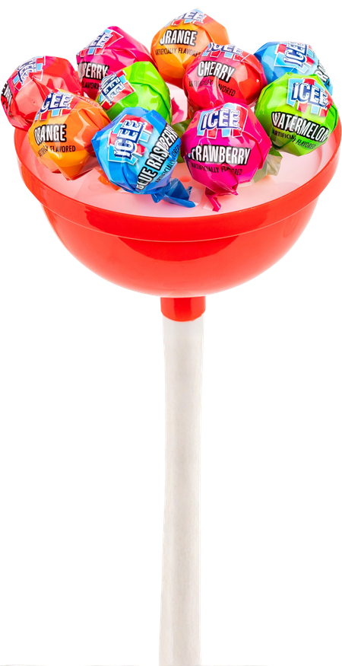
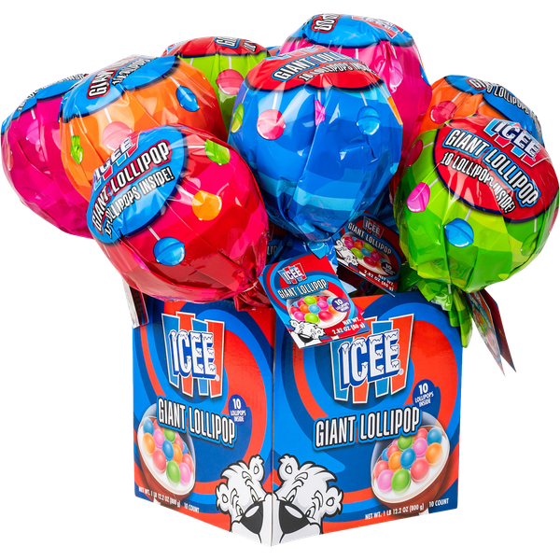
ICEE® Giant Lollipop
#62790
10 per display
2.82 oz (80g) of candy
Display
6.7 x 6.7 x 15"
1 display box per case
Pricing
List unit cost: $4.21
©2026 The ICEE Company. ©2026 Koko’s Confectionery & Novelty. All Rights Reserved.

Slide 19
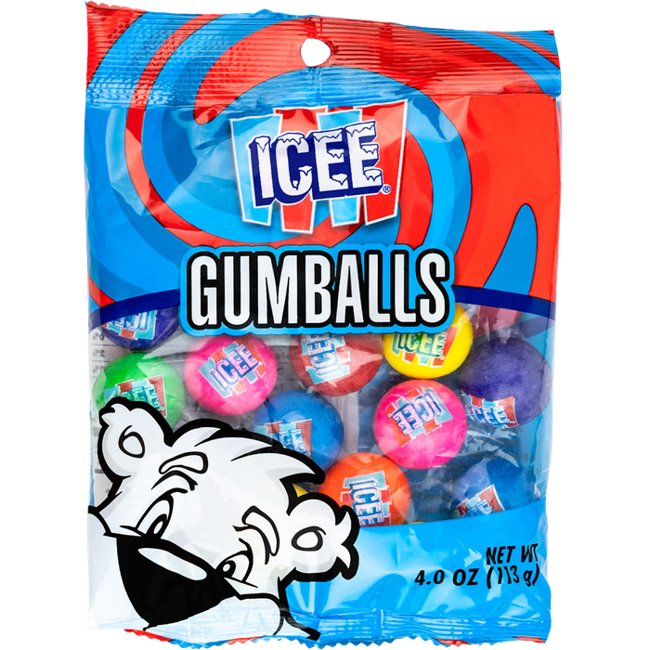
ICEE® Gumballs
#62729
4.0 oz (113g) of candy
Peg Bag
12 per case
Pricing
List unit cost: $1.05
©2026 The ICEE Company. ©2026 Koko’s Confectionery & Novelty. All Rights Reserved.

Slide 20
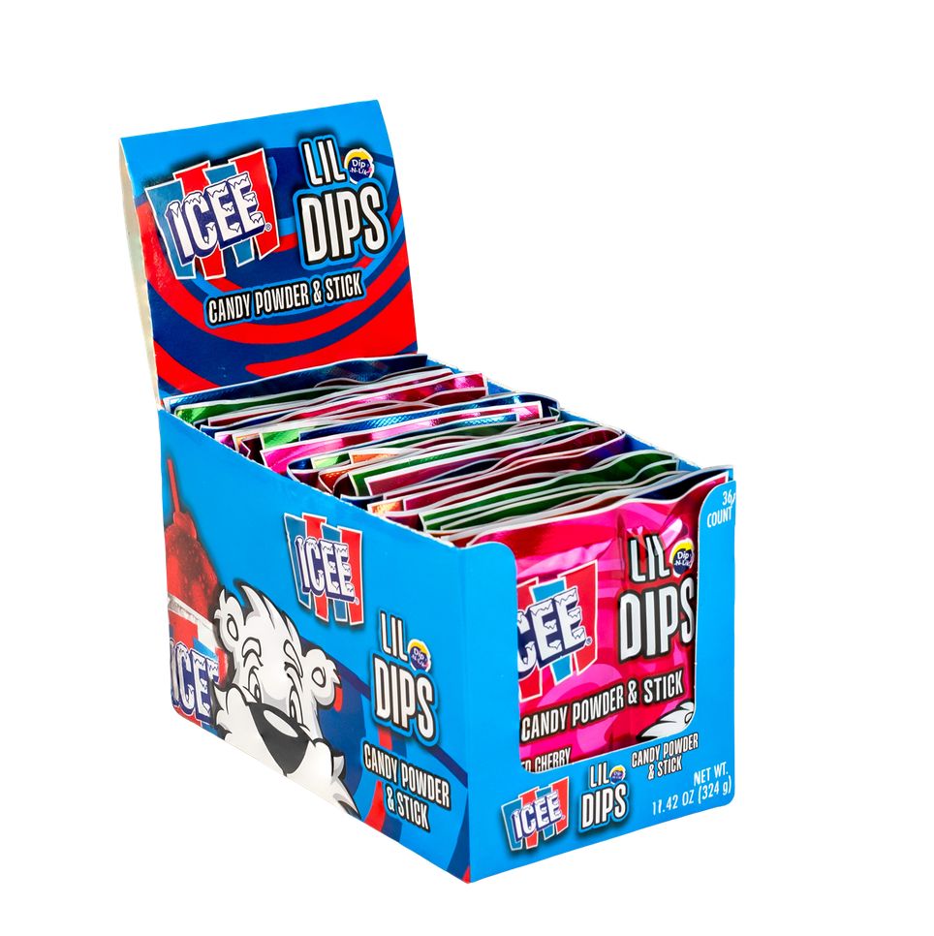
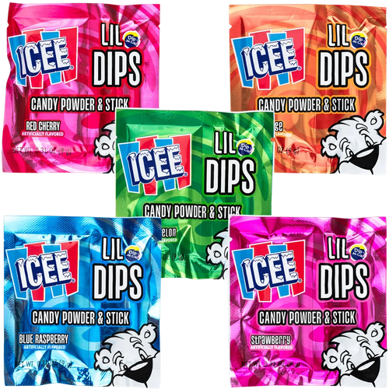
ICEE® Lil Dips -
Candy Powder/Stick
#62761
36 per display
0.31 oz (9g) of candy
Display
3.5 x 6.93 x 3.75"
12 display boxes per case
Pricing
List unit cost: $0.14
©2026 The ICEE Company. ©2026 Koko’s Confectionery & Novelty. All Rights Reserved.

Slide 21
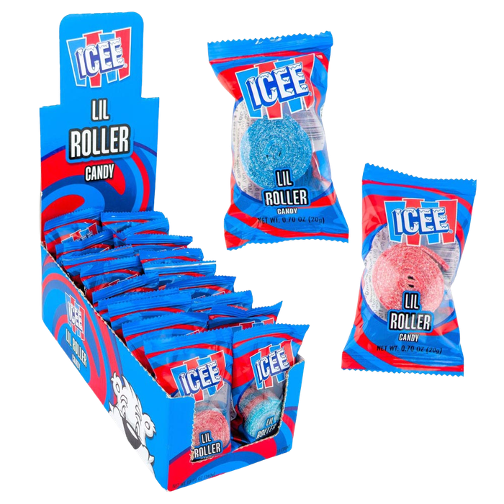
NEW
ITEM!
ICEE® Lil Roller
Candy Belt
#62804
18 per display
0.7 oz (20g) of candy
Display
6.5 x 8.9 x 3.5"
6 display boxes per case
Pricing
List unit cost: $0.49
©2026 The ICEE Company. ©2026 Koko’s Confectionery & Novelty. All Rights Reserved.

Slide 22
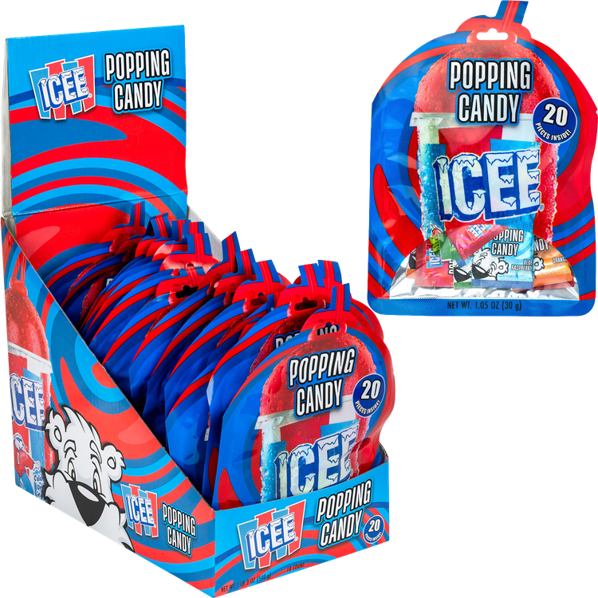
NEW
ITEM!
ICEE® Popping Candy
Party Pack
#62798
18 per display
1.05 oz (30g) of candy
Display
6 x 10.25 x 8.86"
2 display boxes per case
Pricing
List unit cost: $1.03
©2026 The ICEE Company. ©2026 Koko’s Confectionery & Novelty. All Rights Reserved.

Slide 23
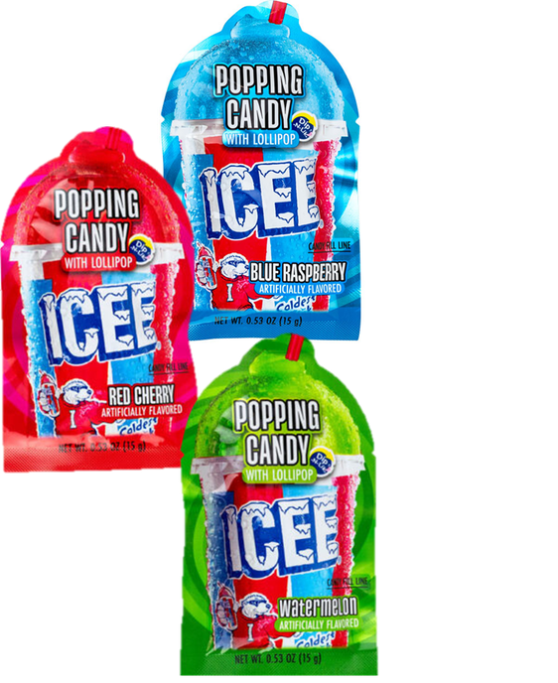
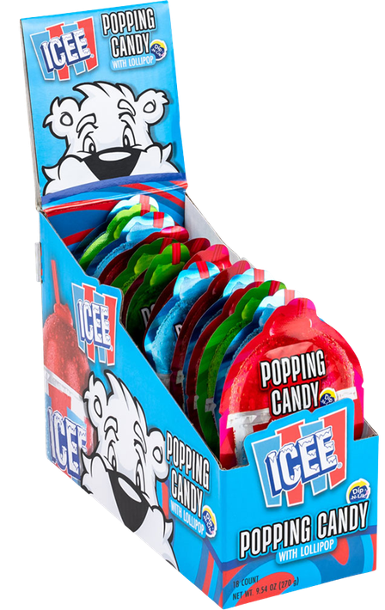
ICEE® Popping Candy
with Lollipop
#12200
18 per display
0.53 oz (15g) of candy
Display
3.38 x 7.88 x 5.5"
6 display boxes per case
Pricing
List unit cost: $0.55
©2026 The ICEE Company. ©2026 Koko’s Confectionery & Novelty. All Rights Reserved.

Slide 24
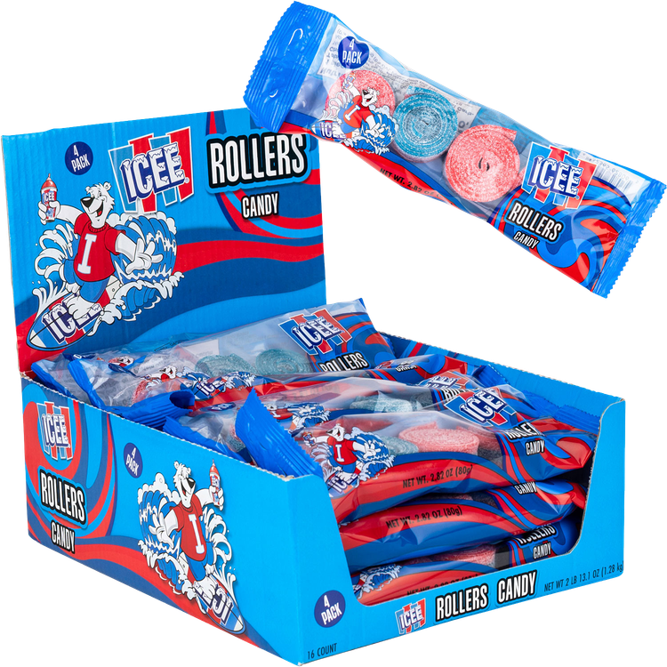
NEW
ITEM!
ICEE® Roller
Candy Belts 4pk
#62806
16 per display
2.82 oz (80g) of candy
Display
7.25 x 9 x 3.25"
8 display boxes per case
Pricing
List unit cost: $1.47
©2026 The ICEE Company. ©2026 Koko’s Confectionery & Novelty. All Rights Reserved.

Slide 25
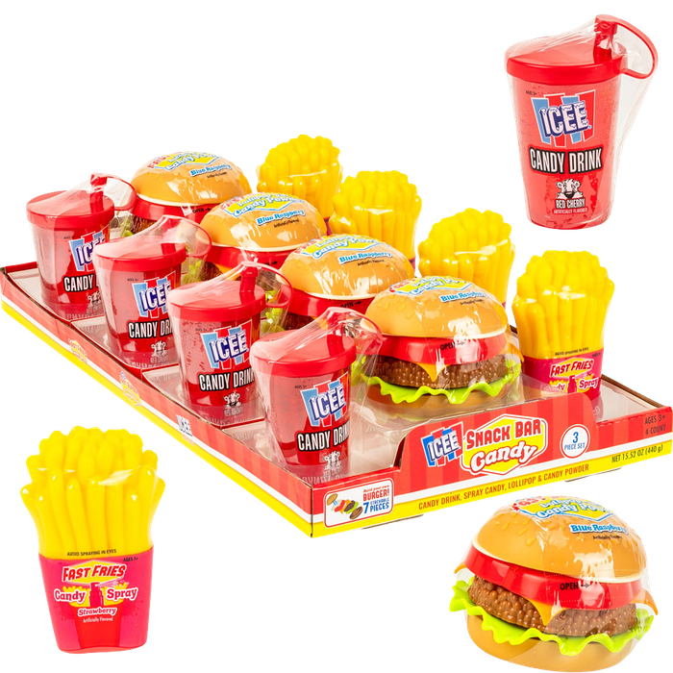
ICEE® Snack Bar 3pc Set
#62722
4 per display tray
3.88 oz (110g) of candy
Display
7.56 x 14.38 x 3.75"
2 display trays per case
Pricing
List unit cost: $3.19
©2026 The ICEE Company. ©2026 Koko’s Confectionery & Novelty. All Rights Reserved.

Slide 26
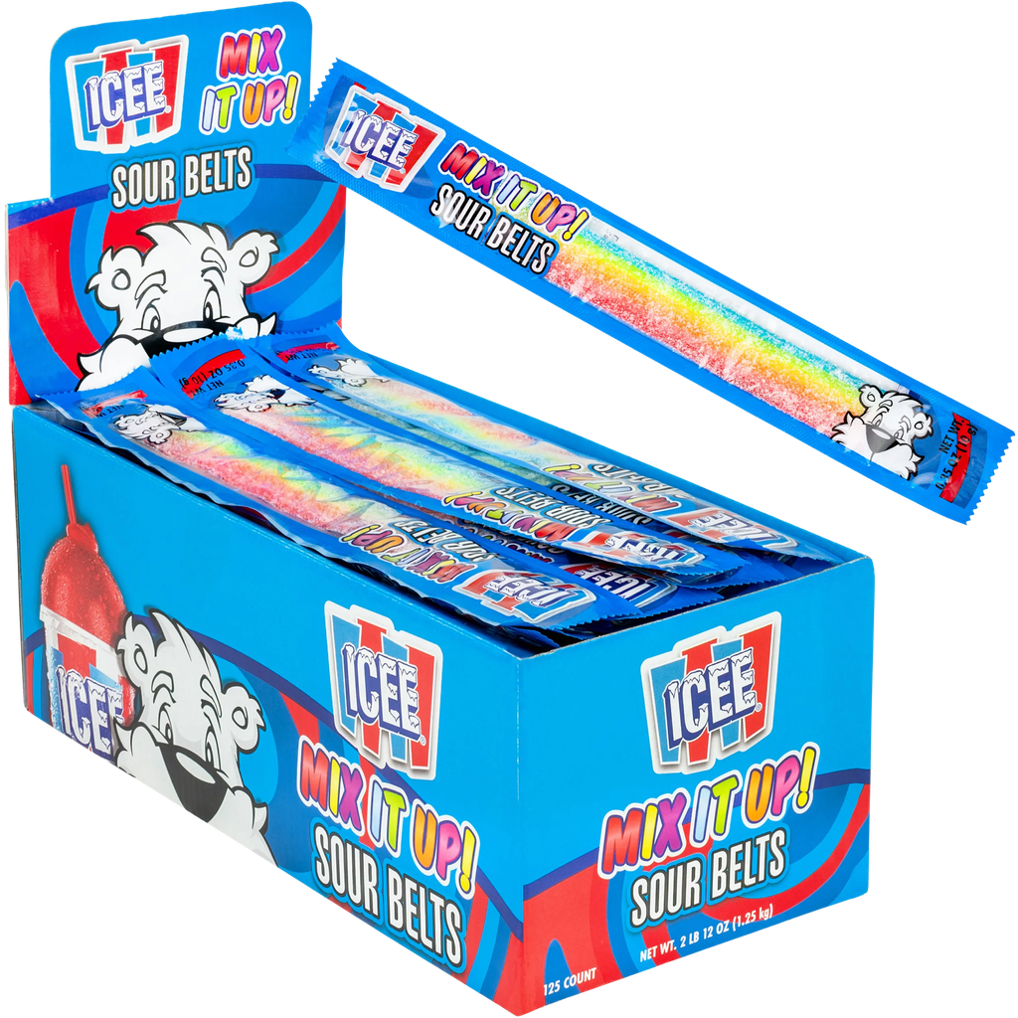
ICEE® ‘Mix it Up’
Sour Belts
#62748
125 per display
0.35 oz (10g) of candy
Display
4.88 x 10.31 x 4.25"
8 display boxes per case
Pricing
List unit cost: $0.11
©2026 The ICEE Company. ©2026 Koko’s Confectionery & Novelty. All Rights Reserved.

Slide 27
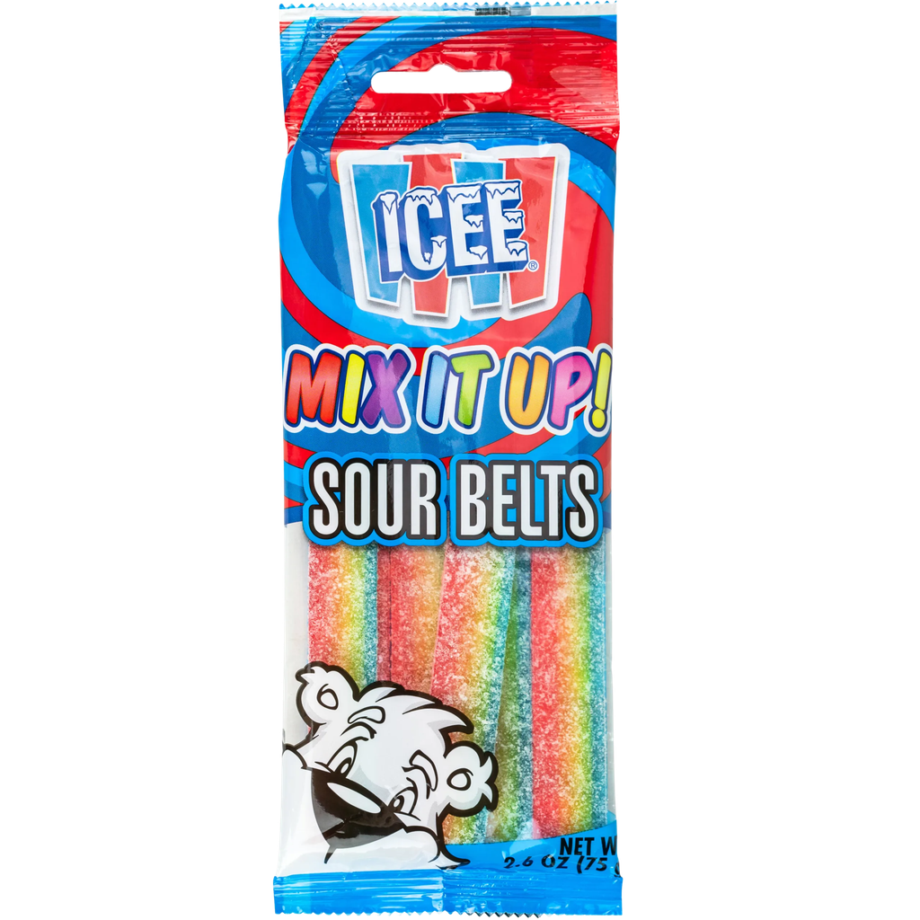
ICEE® Sour Belts
#62749
2.6 oz (75g) of candy
Peg Bag
20 bags per case
Pricing
List unit cost: $1.05
©2026 The ICEE Company. ©2026 Koko’s Confectionery & Novelty. All Rights Reserved.

Slide 28
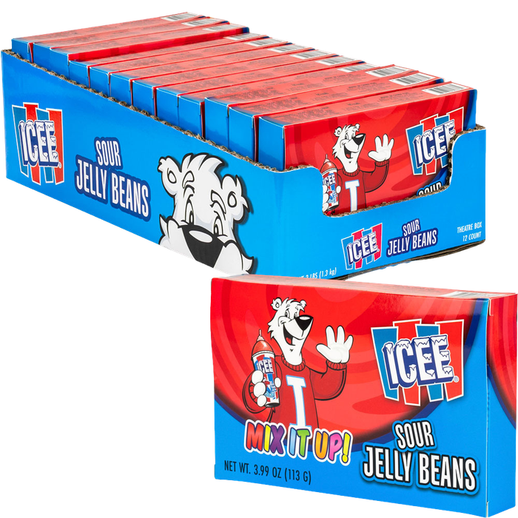
ICEE® ‘Mix It Up!’
Sour Jelly Beans
#62776
3.99 oz (113g) of candy
12 per case
Pricing
List unit cost: $1.03
©2026 The ICEE Company. ©2026 Koko’s Confectionery & Novelty. All Rights Reserved.

Slide 29
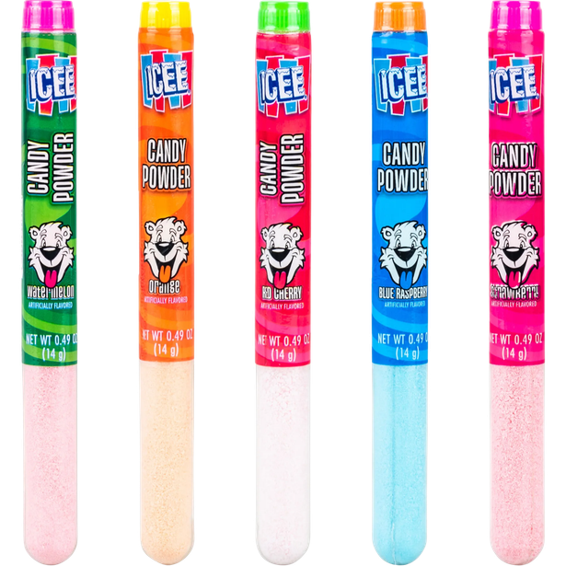
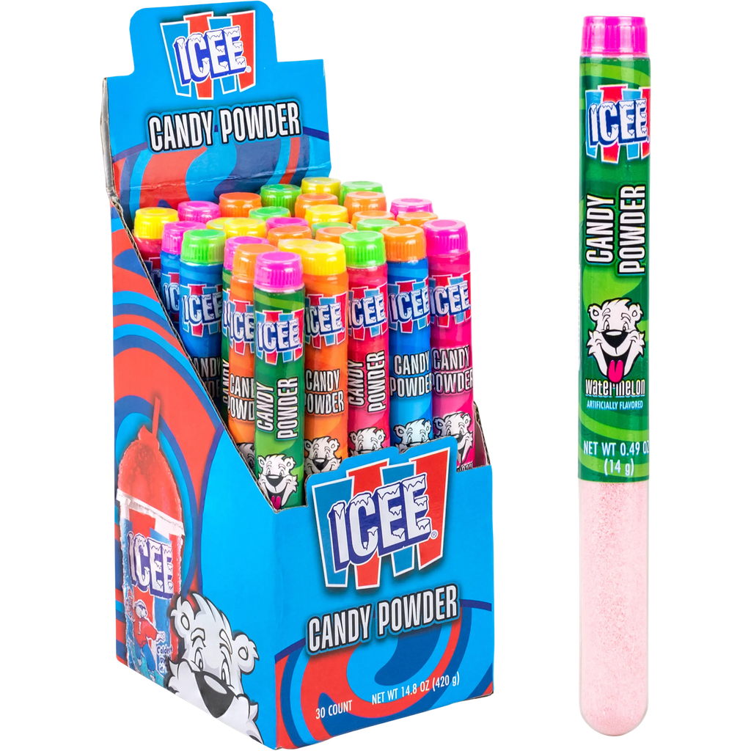
ICEE® Candy Powder Tubes
#62742
30 per display
0.49 oz (14g) of candy
Display
3.25 x 3.75 x 6.13"
12 display boxes per case
Pricing
List unit cost: $0.23
©2026 The ICEE Company. ©2026 Koko’s Confectionery & Novelty. All Rights Reserved.

Slide 30
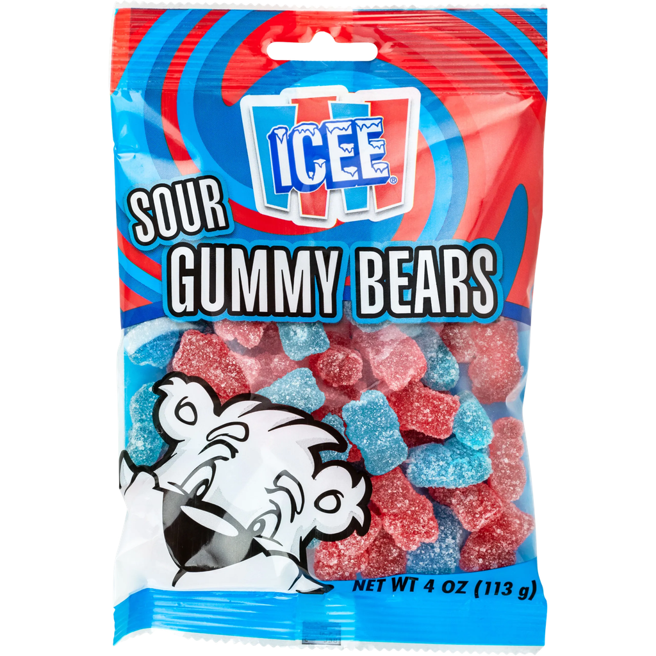
ICEE® Sour
Gummy Bears
#62750
4 oz (113g) of candy
Peg Bag
12 bags per case
Pricing
List unit cost: $1.19
©2026 The ICEE Company. ©2026 Koko’s Confectionery & Novelty. All Rights Reserved.

Slide 31
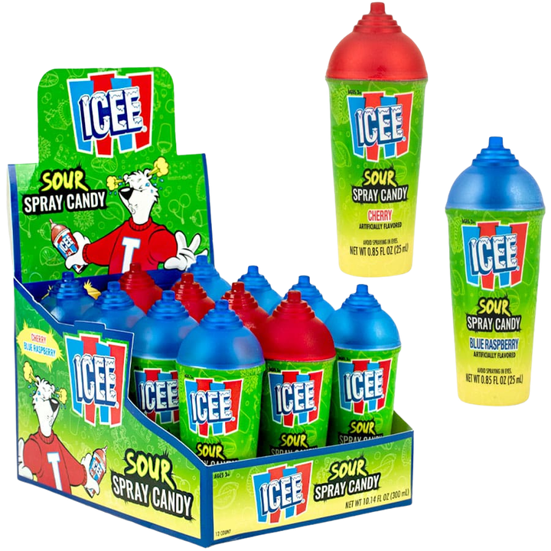
ICEE® Sour
Spray Candy
#62702
12 per display
0.85 fl oz (25mL) of candy
Display
4.65 x 6.07 x 4.06"
8 display boxes per case
Pricing
List unit cost: $1.03
©2026 The ICEE Company. ©2026 Koko’s Confectionery & Novelty. All Rights Reserved.

Slide 32
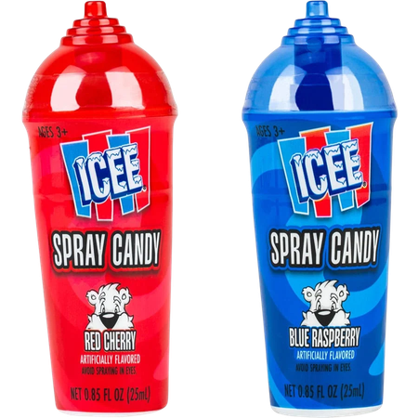
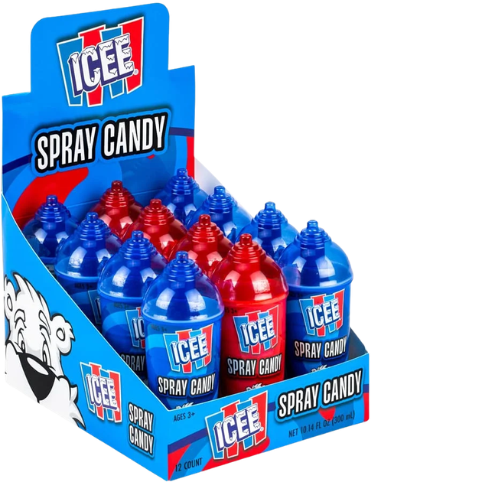
Best Seller & All-Time Favorite
Best Seller & All-Time Favorite
ICEE® Spray Candy
#12214
12 per display
0.85 fl oz (25mL) of candy
Display
4.92 x 6.42 x 4.17"
8 display boxes per case
Pricing
List unit cost: $1.03
©2026 The ICEE Company. ©2026 Koko’s Confectionery & Novelty. All Rights Reserved.

Slide 33
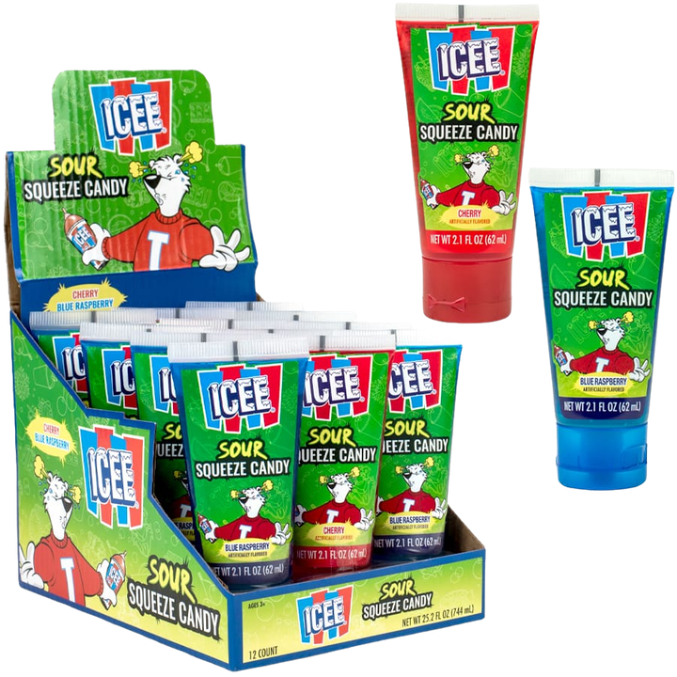
ICEE® Sour
Squeeze Candy
#62704
12 per display
2.1 fl oz (62mL) of candy
Display
4.96 x 6.63 x 4.92"
6 display boxes per case
Pricing
List unit cost: $1.03
©2026 The ICEE Company. ©2026 Koko’s Confectionery & Novelty. All Rights Reserved.

Slide 34
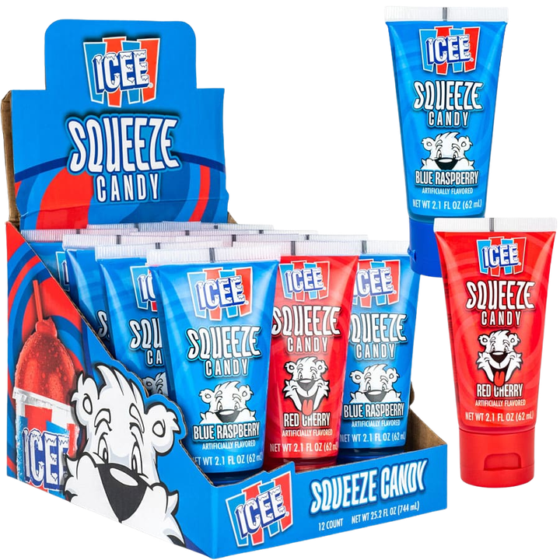
Best Seller & All-Time Favorite
Best Seller & All-Time Favorite
ICEE® Squeeze Candy
#12218
12 per display
2.1 fl oz (62mL) of candy
Display
4.96 x 6.61 x 5.12"
6 display boxes per case
Pricing
List unit cost: $1.03
©2026 The ICEE Company. ©2026 Koko’s Confectionery & Novelty. All Rights Reserved.

Slide 36

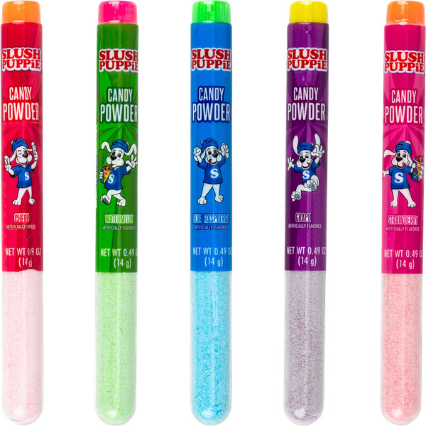
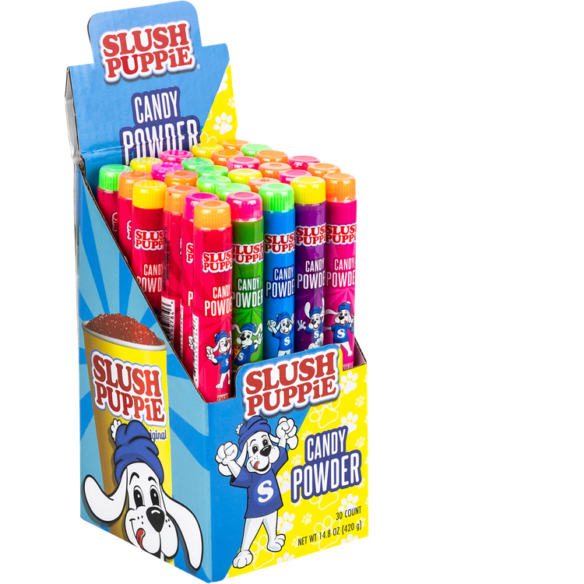
SLUSH PUPPiE®
Candy Powder
#62784
30 per display
0.49 oz (14g) of candy
Display
3.25 x 3.75 x 6.13"
12 display boxes per case
Pricing
List unit cost: $0.23
©2026 SLUSH PUPPiE. ©2026 Koko’s Confectionery & Novelty. All Rights Reserved.

Slide 37
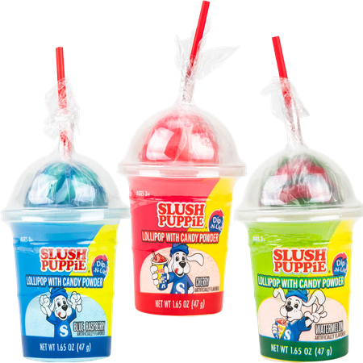
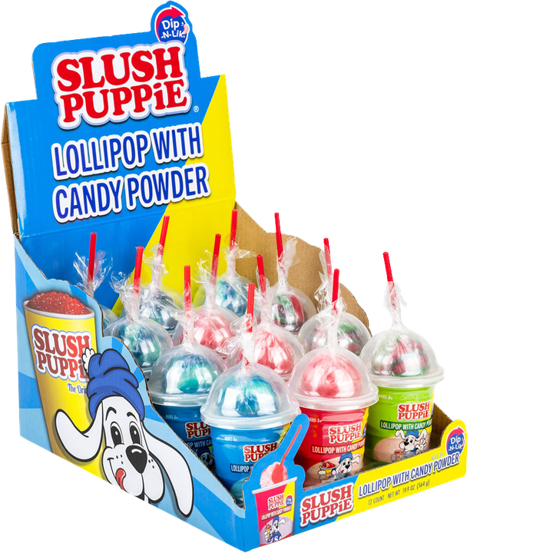
SLUSH PUPPiE®
Dip-N-Lik®
#12365
12 per display
1.65 oz (47g) of candy
Display
6.85 x 9.13 x 5.35"
8 display boxes per case
Pricing
List unit cost: $1.03
©2026 SLUSH PUPPiE. ©2026 Koko’s Confectionery & Novelty. All Rights Reserved.

Slide 38

NEW
ITEM!
SLUSH PUPPiE®
Double Dip-N-Lik®
#62812
12 per display
2.3 oz (65g) of candy
Display
6.13 x 5.2 x 5.8"
8 display boxes per case
Pricing
List unit cost: $1.03
©2026 SLUSH PUPPiE. ©2026 Koko’s Confectionery & Novelty. All Rights Reserved.

Slide 39


SLUSH PUPPiE®
Double Squeeze Candy
#12504
12 per display
2.8 oz (80g) of candy
Display
6.02 x 7.99 x 5.04"
6 display boxes per case
Pricing
List unit cost: $1.51
©2026 SLUSH PUPPiE. ©2026 Koko’s Confectionery & Novelty. All Rights Reserved.

Slide 40

SLUSH PUPPiE®
Lil Dips
#62763
36 per display
0.31 oz (9g) of candy
Display
3.5 x 6.93 x 3.75"
12 display boxes per case
Pricing
List unit cost: $0.14
©2026 SLUSH PUPPiE. ©2026 Koko’s Confectionery & Novelty. All Rights Reserved.

Slide 41


SLUSH PUPPiE®
Spray Candy
#12214-SP
12 per display
0.85 fl oz (25mL) of candy
Display
4.92 x 6.42 x 4.17"
8 display boxes per case
Pricing
List unit cost: $1.03
©2026 SLUSH PUPPiE. ©2026 Koko’s Confectionery & Novelty. All Rights Reserved.

Slide 42


SLUSH PUPPiE®
Squeeze Candy
#12218-SP
12 per display
2.1 fl oz (62mL) of candy
Display
4.96 x 6.61 x 5.12"
6 display boxes per case
Pricing
List unit cost: $1.03
©2026 SLUSH PUPPiE. ©2026 Koko’s Confectionery & Novelty. All Rights Reserved.

Slide 44


Dippin’ Dots® Coated Popping Candy
#62578
20 per display
0.53 oz (15g) of candy
Display
3.13 x 5.56 x 4.75"
6 display boxes per case
Pricing
List unit cost: $0.55
©2026 Dippin’ Dots, LLC. ©2026 Koko’s Confectionery & Novelty. All Rights Reserved.

Slide 45


Dippin’ Dots®
Dip-N-Lik®
#62724
12 per display
1.34 oz (38g) of candy
Display
7.87 x 10.43 x 4.75"
8 display boxes per case
Pricing
List unit cost: $1.03
©2026 Dippin’ Dots, LLC. ©2026 Koko’s Confectionery & Novelty. All Rights Reserved.

Slide 46

Dippin’ Dots®
Filled Gumballs
#62554
24 per display
1.41 oz (40g) of candy
Display
6.75 x 8.13 x 3"
12 display boxes per case
Pricing
List unit cost: $0.56
©2026 Dippin’ Dots, LLC. ©2026 Koko’s Confectionery & Novelty. All Rights Reserved.

Slide 47

Dippin’ Dots®
Taffy Bites Cup
#62778
12 per display
2.1 oz (60g) of candy
Display
6.5 x 9 x 3.5"
8 display boxes per case
Pricing
List unit cost: $1.03
©2026 Dippin’ Dots, LLC. ©2026 Koko’s Confectionery & Novelty. All Rights Reserved.

Slide 48

Dippin’ Dots®
Taffy Bites Candy Bags
#62780
36 per display
0.88 oz (25g) of candy
Display
6.5 x 9 x 3.5"
6 display boxes per case
Pricing
List unit cost: $0.38
©2026 Dippin’ Dots, LLC. ©2026 Koko’s Confectionery & Novelty. All Rights Reserved.

Slide 50


Adorable Animal
Dip-N-Lik®
#62731
12 per display
1.41 oz (40g) of candy
Display
6.13 x 8.13 x 4.5"
8 display boxes per case
Pricing
List unit cost: $1.00
©2026 Koko’s Confectionery & Novelty. All Rights Reserved.

Slide 51



Alien Twist-N-Lik®
#62688
12 per display
0.8 oz (25g) of candy
Display
6.75 x 8.63 x 4.38"
8 display boxes per case
Pricing
List unit cost: $1.00
©2026 Koko’s Confectionery & Novelty. All Rights Reserved.

Slide 52

Candy Fan
#10227
12 per display
0.5 oz (16g) of candy
Display
6.88 x 7.01 x 5.51"
12 display boxes per case
Pricing
List unit cost: $1.00
©2026 Koko’s Confectionery & Novelty. All Rights Reserved.

Slide 53


Candy Hot Pot
#62772
12 per display
1.59 oz (45g) of candy
Display
7.1 x 10.5 x 6.3"
4 display boxes per case
Pricing
List unit cost: $1.24
©2026 Koko’s Confectionery & Novelty. All Rights Reserved.

Slide 54

Clacker Toy & Candy
#62670
12 per display
0.56 oz (16g) of candy
Display
5.74 x 8.27 x 6.30"
8 display boxes per case
Pricing
List unit cost: $1.00
©2026 Koko’s Confectionery & Novelty. All Rights Reserved.

Slide 55


Crank Pop
#62552
16 per display
0.81 oz (23g) of candy
Display
5 x 7.3 x 6.6"
8 display boxes per case
Pricing
List unit cost: $1.00
©2026 Koko’s Confectionery & Novelty. All Rights Reserved.

Slide 56


Crazy Bird Dip-N-Lik®
#62642
12 per display
0.95 oz (27g) of candy
Display
6.5 x 6.56 x 5.25"
8 display boxes per case
Pricing
List unit cost: $1.22
©2026 Koko’s Confectionery & Novelty. All Rights Reserved.

Slide 57


Egg Pop Dip-N-Lik®
#62720
12 per display
1.05 oz (30g) of candy
Display
6.81 x 9 x 3.38"
8 display boxes per case
Pricing
List unit cost: $1.00
©2026 Koko’s Confectionery & Novelty. All Rights Reserved.

Slide 58

Hot Novelties!
Hot Novelties!
Fast Burger Dip-N-Lik®
#62664
12 per display
0.74 oz (21g) of candy
Display
6.25 x 9.25 x 5.2"
8 display boxes per case
Pricing
List unit cost: $1.22
©2026 Koko’s Confectionery & Novelty. All Rights Reserved.

Slide 59


Giant Charms
Blow Pop™
#62718
6 per display
5 oz (144g) of candy
Display
14 x 9.5 x 13"
1 display box per case
Pricing
List unit cost: $6.86
©2026 Koko’s Confectionery & Novelty. All Rights Reserved. ©2026 Tootsie Roll Industries, LLC.

Slide 60


Giant Tootsie Pop™
#62717
6 per display
4.8 oz (136g) of candy
Display
14 x 9.5 x 13"
1 display box per case
Pricing
List unit cost: $6.86
©2026 Koko’s Confectionery & Novelty. All Rights Reserved. ©2026 Tootsie Roll Industries, LLC.

Slide 61


NEW
ITEM!
GloPopcifier® Light-Up Lollipop
#74401
12 per display
1 oz (28g) of candy
Display
7.25 x 10.5 x 6.5"
6 display boxes per case
Pricing
List unit cost: $1.15
©2026 Koko’s Confectionery & Novelty. All Rights Reserved.

Slide 62

Hot Novelties!
Hot Novelties!
Gnome Dip-N-Lik®
#62733
12 per display
2.57 oz (73g) of candy
Display
5.75 x 10.25 x 4.75"
8 display boxes per case
Pricing
List unit cost: $0.93
©2026 Koko’s Confectionery & Novelty. All Rights Reserved.

Slide 63


NEW
ITEM!
Hot Novelties!
Hot Novelties!
Gummy Fries
Dip-N-Lik®
#62822
12 per display
1.57 oz (45g) of candy
Display
5.13 x 8.5 x 4"
8 display box per case
Pricing
List unit cost: $1.22
©2026 Koko’s Confectionery & Novelty. All Rights Reserved.

Slide 64

Gummy Sushi Candy
#62770
18 per display
0.63 oz (18g) of candy
Display
3.5 x 9.63 x 3.75"
8 display boxes per case
Pricing
List unit cost: $0.43
©2026 Koko’s Confectionery & Novelty. All Rights Reserved.

Slide 65



Best Seller & All-Time Favorite
Best Seller & All-Time Favorite
Ice Cream Candy
Twist-N-Lik®
#10266
12 per display
0.64 fl oz (19mL) of candy
Display
5.91 x 7.87 x 4.84"
8 display boxes per case
Pricing
List unit cost: $1.00
©2026 Koko’s Confectionery & Novelty. All Rights Reserved.

Slide 66


Light-Up Spaceship
Squeeze Candy
#10264
12 per display
1.18 fl oz (35ml) of candy
Display
5.4 x 4 x 7.5"
6 display boxes per case
Pricing
List unit cost: $1.22
©2026 Koko’s Confectionery & Novelty. All Rights Reserved.

Slide 67


Liquid Lolli
Sour Squeeze
#62800
12 per display
4 oz (114g) of candy
Display
4.45 x 9.45 x 5.94"
6 display boxes per case
Pricing
List unit cost: $1.00
©2026 Koko’s Confectionery & Novelty. All Rights Reserved.

Slide 68


Fan Favorite
Fan Favorite
Mr. Squeezy Pop®
Squeeze-N-Lik®
#62684
12 per display
1.97 oz (56g) of candy
Display
6.13 x 5.19 x 5.8"
8 display boxes per case
Pricing
List unit cost: $1.12
©2026 Koko’s Confectionery & Novelty. All Rights Reserved.

Slide 69


Best Seller & All-Time Favorite
Best Seller & All-Time Favorite
Popcifier® Dip-N-Lik®
#10269
12 per display
1.13 oz (32g) of candy
Display
6.93 x 6.22 x 3.86"
12 display boxes per case
Pricing
List unit cost: $1.00
©2026 Koko’s Confectionery & Novelty. All Rights Reserved.

Slide 70


PuppyPalz®
Dip-N-Lik®
#62737
12 per display
1.41 oz (40g) of candy
Display
5.5 x 7.38 x 4.63"
8 display boxes per case
Pricing
List unit cost: $1.00
©2026 Koko’s Confectionery & Novelty. All Rights Reserved.

Slide 71


Snake Spray Candy
#55570
16 per display
1.22 fl oz (36ml) of candy
Display
5.5 x 5.38 x 6.88"
12 display boxes per case
Pricing
List unit cost: $1.00
©2026 Koko’s Confectionery & Novelty. All Rights Reserved.

Slide 72

Splash Potty
Dip-N-Lik®
#62640
12 per display
0.95oz (27g) of candy
Display
6.85 x 9.65 x 5.83"
8 display boxes per case
Pricing
List unit cost: $1.00
©2026 Koko’s Confectionery & Novelty. All Rights Reserved.

Slide 73



Splash-N-Lik®
with Popping Candy
#62604
12 per display
2.57oz (73g) of candy
Display
6.85 x 9.13 x 5.25"
8 display boxes per case
Pricing
List unit cost: $1.00
©2026 Koko’s Confectionery & Novelty. All Rights Reserved.

Slide 74


NEW
ITEM!
Hot Novelties!
Hot Novelties!
Squeezy Paint Pop
#62788
12 per display
1.1 oz (32g) of candy
Display
3.31 x 7.28 x 5.47"
12 display boxes per case
Pricing
List unit cost: $1.00
©2026 Koko’s Confectionery & Novelty. All Rights Reserved.

Slide 75


Squeezy Squirt Pop®
Candy
#62582
12 per display
1.06 oz (30g) of candy
Display
4.8 x 7 x 4.5"
8 display boxes per case
Pricing
List unit cost: $1.00
©2026 Koko’s Confectionery & Novelty. All Rights Reserved.

Slide 76


Sweet Shots Basketball
Toy with Candy
#62638
12 per display
0.56 oz (16g) of candy
Display
6.88 x 7.09 x 6.10"
8 display boxes per case
Pricing
List unit cost: $0.93
©2026 Koko’s Confectionery & Novelty. All Rights Reserved.

Slide 77

NEW
ITEM!
Hot Novelties!
Hot Novelties!
Triple Squeeze
#62808
12 per display
1.9 oz (54g) of candy
Display
5.2 x 6.7 x 5.7"
8 display boxes per case
Pricing
List unit cost: $1.00
©2026 Koko’s Confectionery & Novelty. All Rights Reserved.

Slide 78

Unicorn Dip-N-Lik®
#62735
12 per display
2.08 oz (59g) of candy
Display
5.75 x 9.25 x 5.38"
8 display boxes per case
Pricing
List unit cost: $1.00
©2026 Koko’s Confectionery & Novelty. All Rights Reserved.

Slide 79



Best Seller & All-Time Favorite
Best Seller & All-Time Favorite
World’s Greatest
Candy Necklace™
#38221
24 per display
0.77 oz (22g) of candy
Display
7.5 x 4.25 x 6.5"
24 display boxes per case
Pricing
List unit cost: $0.25
©2026 Koko’s Confectionery & Novelty. All Rights Reserved.

Slide 80

Best Seller & All-Time Favorite
Best Seller & All-Time Favorite
World’s Biggest
Candy Necklace™
#38500
24 per display
2.1 oz (60g) of candy
Display
4.5 x 6 x 20"
6 display boxes per case
Pricing
List unit cost: $1.00
©2026 Koko’s Confectionery & Novelty. All Rights Reserved.

Slide 81

Best Seller & All-Time Favorite
Best Seller & All-Time Favorite
World’s Biggest SOUR
Candy Necklace™
#38600
24 per display
2.1 oz (60g) of candy
Display
4.5 x 6 x 20"
6 display boxes per case
Pricing
List unit cost: $1.00
©2026 Koko’s Confectionery & Novelty. All Rights Reserved.

Slide 82

Xtreem Lock Jaw® Dips Sour Powder/Sticks
#62744
18 per display
1.41 oz (40g) of candy
Display
6.3 x 9.45 x 4.34"
12 display boxes per case
Pricing
List unit cost: $0.59
©2026 Koko’s Confectionery & Novelty. All Rights Reserved.

Slide 83

Xtreem Lock Jaw®
Lil Dip Sour Singles
#62762
36 per display
0.31 oz (9g) of candy
Display
3.5 x 6.93 x 3.75"
12 display boxes per case
Pricing
List unit cost: $0.14
©2026 Koko’s Confectionery & Novelty. All Rights Reserved.

Slide 84


Xtreem Lock Jaw®
Sour Powder Tubes
#62746
30 per display
0.49 oz (14g) of candy
Display
3.25 x 3.75 x 6.13"
12 display boxes per case
Pricing
List unit cost: $0.23
©2026 Koko’s Confectionery & Novelty. All Rights Reserved.

Slide 85


BULK
ITEM!
ICEE® Chews
Bulk Bag
#62764
150 pieces per bag
0.56 oz (16g) of candy
4 bags per case
Pricing
List unit cost: $116.64
©2026 The ICEE Company. ©2026 Koko’s Confectionery & Novelty. All Rights Reserved.

Slide 86

BULK
ITEM!
ICEE® Bulk Fizzy
Hard Candy
#62752
144 pieces per bag
0.1 oz (3g) of candy
6 bags per case
Pricing
List unit cost: $28.00
©2026 The ICEE Company. ©2026 Koko’s Confectionery & Novelty. All Rights Reserved.

Slide 87

BULK
ITEM!
ICEE® Lil Dips - Bulk
Candy Powder/Stick
#62751
144 pieces per bag
0.31 oz (9g) of candy
6 bags per case
Pricing
List unit cost: $121.31
©2026 The ICEE Company. ©2026 Koko’s Confectionery & Novelty. All Rights Reserved.

Slide 88

BULK
ITEM!
SLUSH PUPPiE®
Lil Dips
#62760
144 pieces per bag
0.31 oz (9g) of candy
6 bags per case
Pricing
List unit cost: $121.31
©2026 SLUSH PUPPiE. ©2026 Koko’s Confectionery & Novelty. All Rights Reserved.

Slide 89

BULK
ITEM!
SLUSH PUPPiE®
Liquid Fill Hard Candy
#62753
144 pieces per bag
0.1 oz (3g) of candy
6 bags per case
Pricing
List unit cost: $28.00
©2026 SLUSH PUPPiE. ©2026 Koko’s Confectionery & Novelty. All Rights Reserved.

Slide 90

BULK
ITEM!
SLUSH PUPPiE®
Popping Candy
#12513
250 pieces per bag
0.04 oz (1g) of candy
4 bags per case
Pricing
List unit cost: $51.53
©2026 SLUSH PUPPiE. ©2026 Koko’s Confectionery & Novelty. All Rights Reserved.

Slide 91

BULK
ITEM!
Dippin’ Dots®
Chews Bags
#62768
150 pieces per display
0.56 oz (16g) of candy
4 bags per case
Pricing
List unit cost: $116.64
©2026 Dippin’ Dots, LLC. ©2026 Koko’s Confectionery & Novelty. All Rights Reserved.

Slide 92

BULK
ITEM!
Candy Necklace
NECK
100 pieces per bag
0.60 oz (17g) of candy
10 bags per case
Pricing
List unit cost: $157.10
©2026 Koko’s Confectionery & Novelty. All Rights Reserved.

Slide 93

BULK
ITEM!
Candy Watch
WAT
100 pieces per bag
0.42 oz (12g) of candy
10 bags per case
Pricing
List unit cost: $138.18
©2026 Koko’s Confectionery & Novelty. All Rights Reserved.

Slide 94

BULK
ITEM!
Funny Farm Dextrose
#62766
250 pieces per bag
0.35 oz (10g) of candy
2 bags per case
Pricing
List unit cost: $48.60
©2026 Koko’s Confectionery & Novelty. All Rights Reserved.

Slide 95

BULK
ITEM!
Gummy Burger Bulk
#62792
100 pieces per bag
0.32 oz (9g) of candy
5 bags per case
Pricing
List unit cost: $49.95
©2026 Koko’s Confectionery & Novelty. All Rights Reserved.

Slide 96

BULK
ITEM!
Gummy Fries Bulk
#62796
200 pieces per bag
0.21 oz (6g) of candy
5 bags per case
Pricing
List unit cost: $62.75
©2026 Koko’s Confectionery & Novelty. All Rights Reserved.

Slide 97

BULK
ITEM!
Gummy Hot Dog Bulk
#62794
100 pieces per bag
0.32oz (9g) of candy
5 bags per case
Pricing
List unit cost: $49.95
©2026 Koko’s Confectionery & Novelty. All Rights Reserved.

Slide 98

BULK
ITEM!
Sour Gummy Burger Bulk
#62840
100 pieces per bag
0.32oz (9g) of candy
5 bags per case
Pricing
List unit cost: $49.95
©2026 Koko’s Confectionery & Novelty. All Rights Reserved.

Slide 99

BULK
ITEM!
Sour Gummy Hot Dog Bulk
#62842
100 pieces per bag
0.32oz (9g) of candy
5 bags per case
Pricing
List unit cost: $49.95
©2026 Koko’s Confectionery & Novelty. All Rights Reserved.

Slide 100

BULK
ITEM!
Xtreem Lock Jaw®
Sour Hard Candy
#62754
144 pieces per bag
0.1 oz (3g) of candy
6 bags per case
Pricing
List unit cost: $28.00
©2026 Koko’s Confectionery & Novelty. All Rights Reserved.

Slide 101

BULK
ITEM!
Xtreem Lock Jaw®
Sour Lil Dips Bulk
#62755
144 pieces per bag
0.31 oz (9g) of candy
6 bags per case
Pricing
List unit cost: $112.32
©2026 Koko’s Confectionery & Novelty. All Rights Reserved.

Slide 102

Best Seller & All-Time Favorite
Best Seller & All-Time Favorite
ICEE® Dip-N-Lik® Shipper
#75042
72 per display
1.6 oz (47g) of candy
Shipper
25.8 x 18 x 9.4"
Pricing
List unit cost: $74.16
©2026 The ICEE Company. ©2026 Koko’s Confectionery & Novelty. All Rights Reserved.

Slide 103


ICEE® Spray & Squeeze Shipper
#75027
72 per display
Shipper
20.25 x 17.75 x 6.75"
Pricing
List unit cost: $74.16
©2026 The ICEE Company. ©2026 Koko’s Confectionery & Novelty. All Rights Reserved.

Slide 104


Fan Favorite
Fan Favorite
Mr. Squeezy Pop®
Squeeze-N-Lik® Shipper
#50004
1.97 oz (56g) of candy
72 per display
Shipper
20.5 x 17.75 x 8"
Pricing
List unit cost: $80.64
©2026 Koko’s Confectionery & Novelty. All Rights Reserved.

Slide 105


Popcifier® Dip-N-Lik® &
Candy Ice Cream Twist-N-Lik® Shipper
#75018
72 per display
Shipper
20.25 x 18 x 7"
Pricing
List unit cost: $72.00
©2026 Koko’s Confectionery & Novelty. All Rights Reserved.

Slide 106



ICEE® Dip-N-Lik® &
Squeeze Holiday Shipper
#75085
72 per display
Shipper
20.25 x 19 x 8"
Pricing
List unit cost: $74.16
©2026 Koko’s Confectionery & Novelty. All Rights Reserved.

Slide 107

ICEE® Dip-N-Lik® &
Squeeze Shipper
#75086
72 per display
Shipper
20.25 x 19 x 8"
Pricing
List unit cost: $74.16
©2026 Koko’s Confectionery & Novelty. All Rights Reserved.

Slide 108
Thank You!
kokos.com | 800.638.6000 | info@kokos.com

